Slide 1






JupyterHub
Prof. Martin Christen FHNW – University of Applied Sciences and Arts Northwestern Switzerland School of Architecture, Civil Engineering and Geomatics Institute Geomatics
martin.christen@fhnw.ch
MartinChristen GitHub: MartinChristen
GitLab: martin.christen

Slide 2
https://github.com/martinchristen/PythonCamp2019
https://github.com/martinchristen/PythonCamp2019

Slide 3

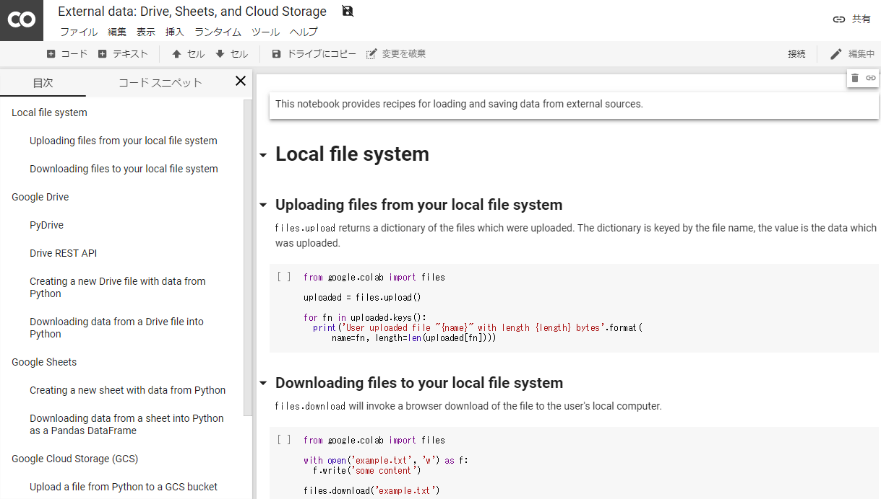
Google Colab
https://colab.research.google.com/
Colaboratory is a free Jupyter notebook environment that requires no setup and runs entirely in the cloud.
Bascially the same like Jupyter, just another layout
Usage is free
You have GPU Support (more about that later)

Slide 4
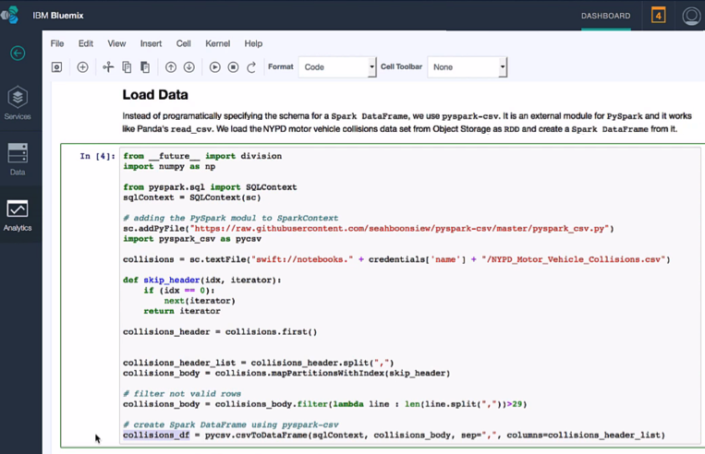
IBM Cloud (previously known as Bluemix)
https://www.ibm.com/cloud/

Slide 5
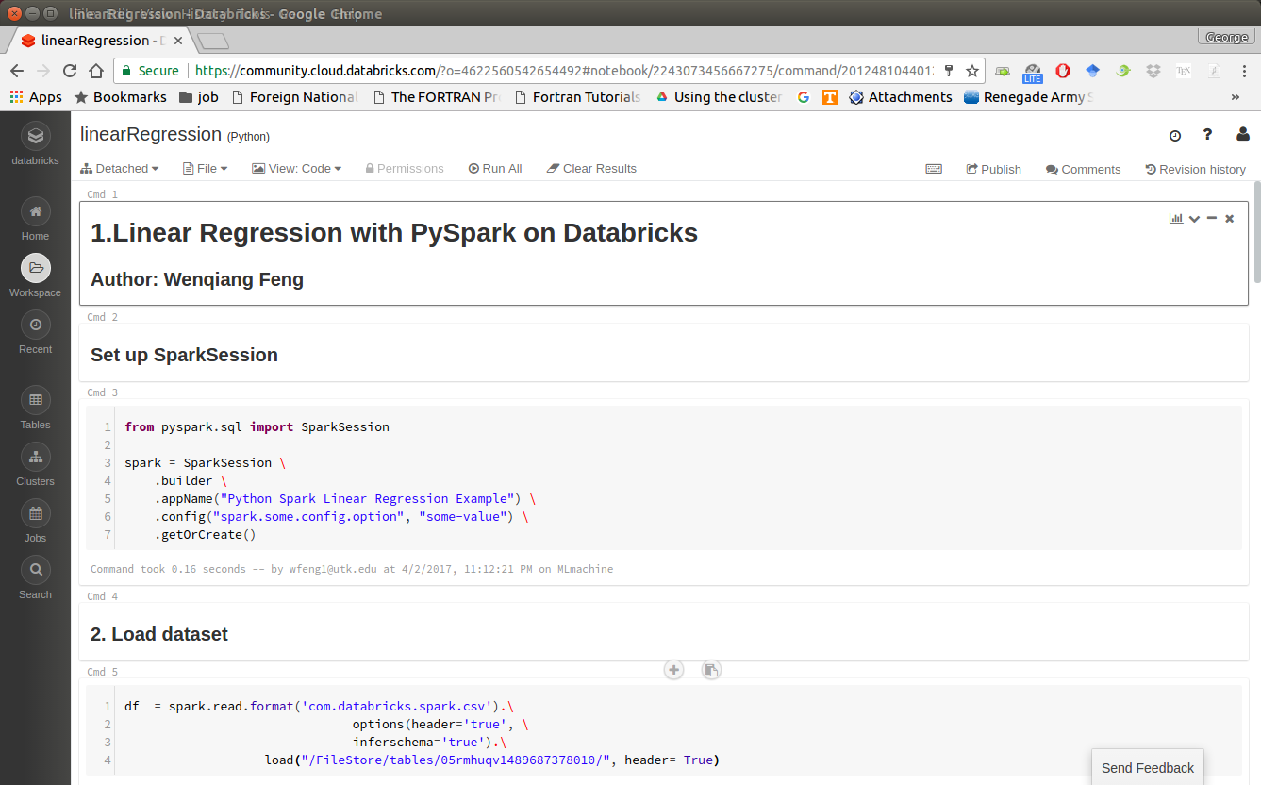
Databricks
https://databricks.com/

Slide 6

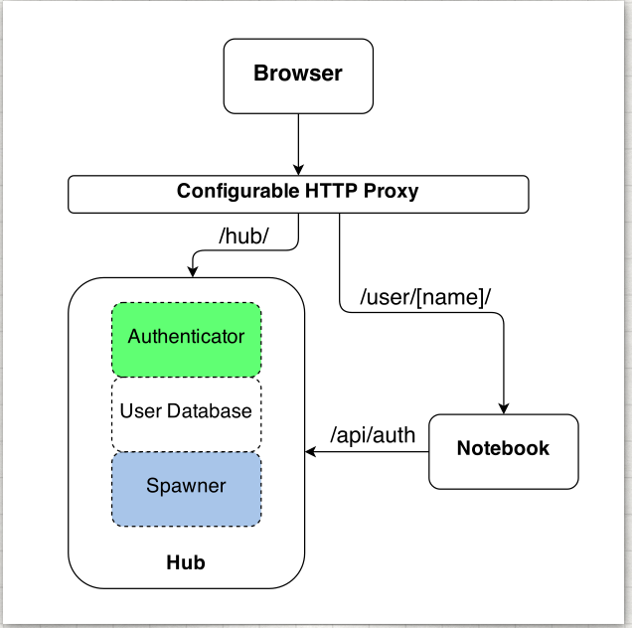
About JupyterHub
Jupyterhub: Jupyter for multiple users
The Hub launches a proxy
The proxy forwards all requests to the Hub by default
The Hub handles user login and spawns single-user servers on demand
The Hub configures the proxy to forward URL prefixes to the single-user notebook servers
Image from https://jupyterhub.readthedocs.io

Slide 7
Authenticators – User Login
Local User
OAuthenticator: GitHub/BitBucket/MediaWiki/CILogon/Google OAuth/…
Dummy Authenticator (For testing only! Not for production use.)
LDAP Authenticator
Kerberos Authenticator
REMOTE_USER Authenticator (For when intermediate login infrastructure such as Apache offloads authentication and forwards REMOTE_USER header.)
JSONWebToken Authenticator (For Authenticating/Authorising users based on a JSONWebToken forwarded in an Authorization: bearer <token> header.)
HashAuthenticator (Each user comes with a predefined password which is a hash of their username. A separate authenticator may be used for admins.)
CASAuthenticator for CAS Single Sign-on SSO

Slide 8
Spawners
BatchSpawner for spawning remote servers using batch systems (Torque, PBS, Slurm, etc)
DockerSpawner, which actually has two different spawners in it:
dockerspawner.DockerSpawner, for spawning identical Docker containers for each user
dockerspawner.SystemUserSpawner, for spawning Docker containers with an environment and home directory for each user
ImageSpawner for allowing users to choose which Docker image to spawn.
KubeSpawner for use with Kubernetes.
MarathonSpawner for spawning instances on Marathon.
UCRSpawner for spawning GPU instances on Marathon.
RemoteSpawner
SimpleSpawner, for testing purposes.
SystemdSpawner, spawns notebooks with the isolation / security benefits of containers without the complexity of image management.
SudoSpawner uses sudo. SystemdSpawner is recommended instead of SudoSpawner, if it is available to you.
WrapSpawner allows spawner class and options to be chosen at runtime. Includes ProfilesSpawner for doing this from a spawner options form. Formerly part of BatchSpawner.

Slide 9
Installation
Installation is easy if you read the docs:
https://jupyterhub.readthedocs.io/en/stable/installation-guide.html
You need Linux
You can use Docker, You can install Jupyterhub without Docker
Spawner in Cluster (makes installation a little bit more complicated)
conda install -c conda-forge jupyterhub
conda install notebook

Slide 10
Configuration
/opt/anaconda3/bin/jupyterhub_config.py
# Custom Logo c.JupyterHub.logo_file = "/path/to/logo.png"
# for Jupyter Lab c.Spawner.cmd = ["jupyter-labhub"] c.Spawner.default_url = '/lab‘ c.Spawner.environment = {'JUPYTER_ENABLE_LAB': 'yes' }

Slide 11
New Kernels
Install new environment
conda create --name mypython36 python=3.6 -y
conda activate mypython36
conda install ipykernel -y
python -m ipykernel install --user --name MyKernel_3.6
List all Kernels:
jupyter kernelspec list
Delete kernel:
jupyter kernelspec remove MyKernel_3.6

Slide 12

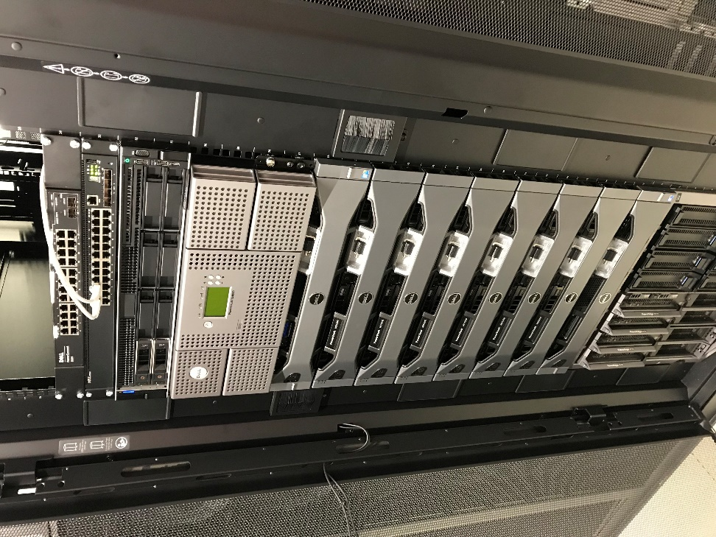
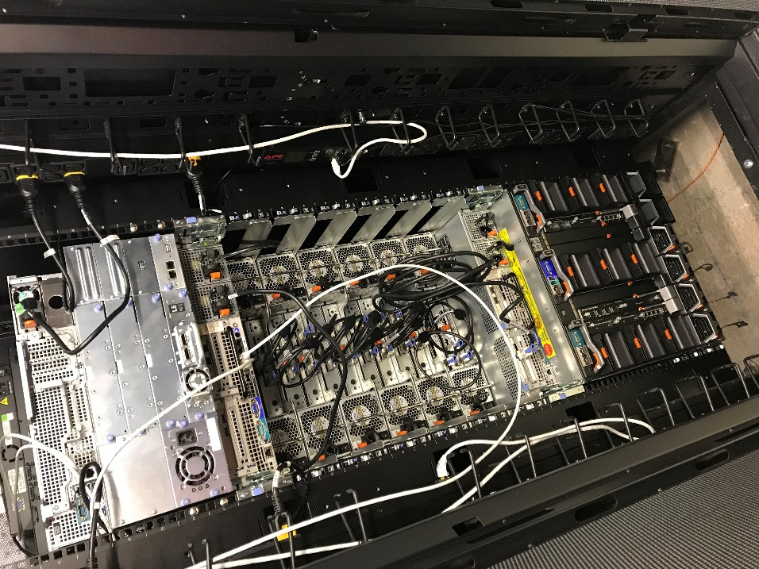
Cluster for JupyterHub
JuypterHub
124 CPU Cores 112 GB RAM 120 TB HD (~1 GB/s read/write)
currently only 4 GPUs, to be increased soon

Slide 13
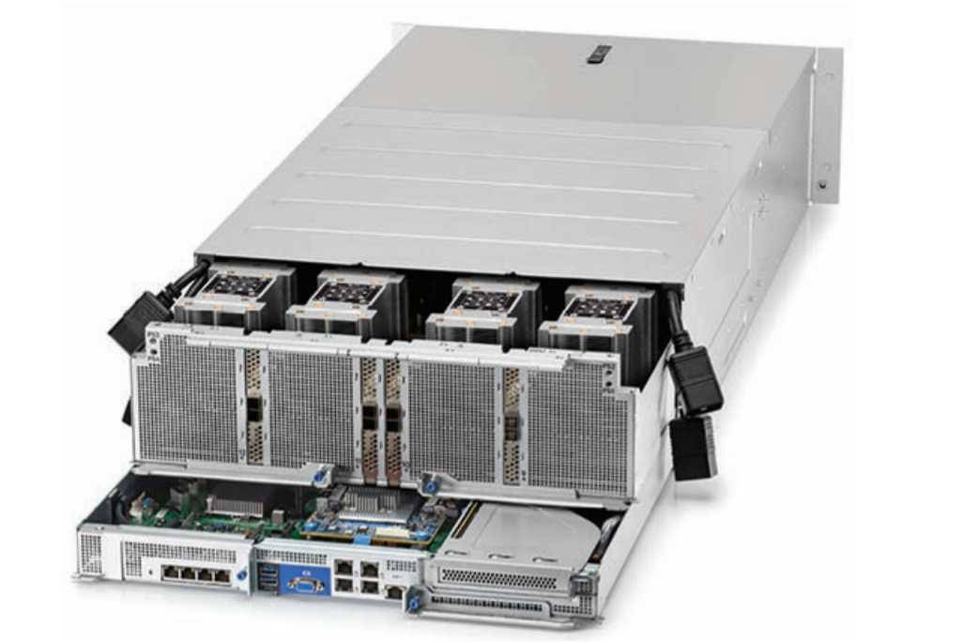
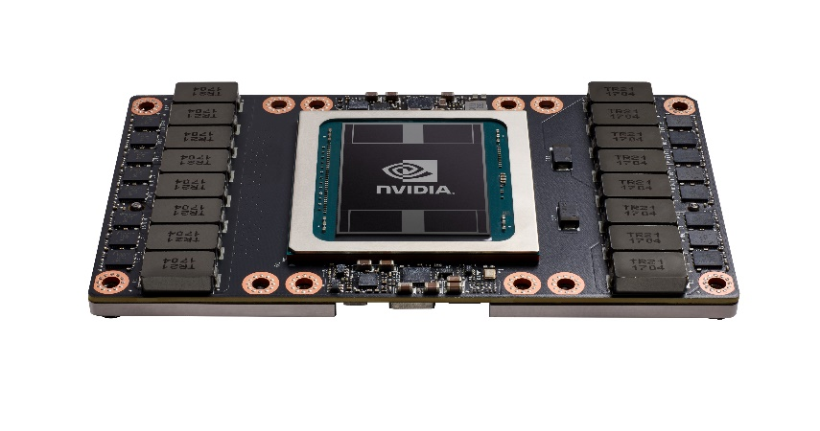
HPC: HPE Apollo 6500 mit JupyterLab
Wurde im Rahmen des F&E Projektes «SolAI» beschafft JupyterLab mit 4 V100 SXM2 GPUs
Ideal für DeepLearning oder andere rechenintensive Tasks
JupyterHub mit:
Python 3.7 – Kernel
Python 3.6 – Kernel
R-Kernel
C++ - Kernel (mit xwidgets/xplot/xtensor)
…
Job-Scheduler
Noch offen
Nvidia Tesla V100 SXM2
21 Milliarden Transistoren
5120 CUDA-cores
900 GB/s Speicherbandbreite
12nm Fertigungstechnik
300W
Entwicklungskosten: 3 Milliarden US$
4x
Notes:
Vorgestellt im März 2018

